Slide 1


Bitcoin Transaction

Slide 2
Main Components of a Bitcoin Network
Digital keys
Addresses
Transactions
Blockchain
Miners
The Bitcoin network
Wallets (client software)

Slide 3
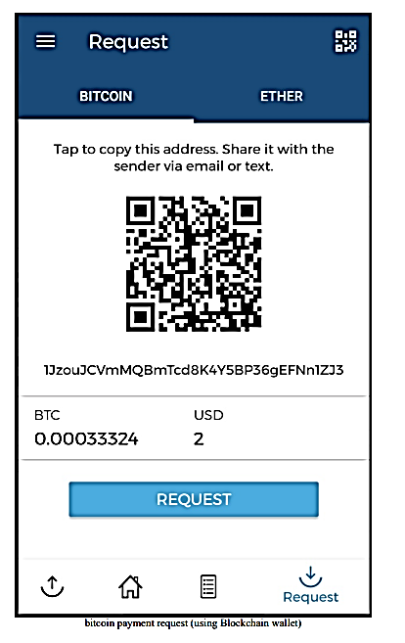
Sending a payment to someone
Address of the Beneficiary
email
SMS
chat applications
any appropriate communication mechanism

Slide 4
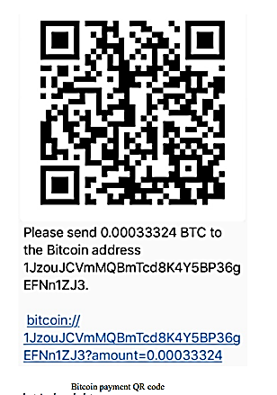
Sender initiates transfer
The sender
enters the receiver's address
scans the QR code that has the Bitcoin address, amount and optional description encoded in it.
The wallet application recognizes this QR code and decodes it into something like
Please send <Amount> BTC to the Bitcoin address <receiver's Bitcoin address>.

Slide 5
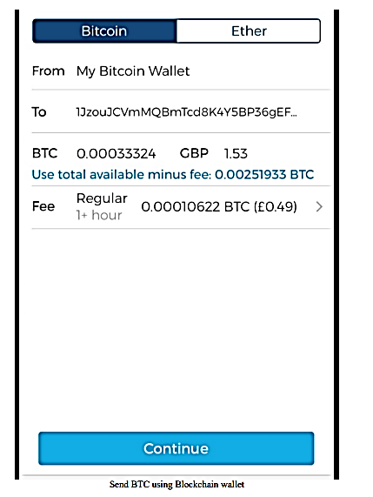
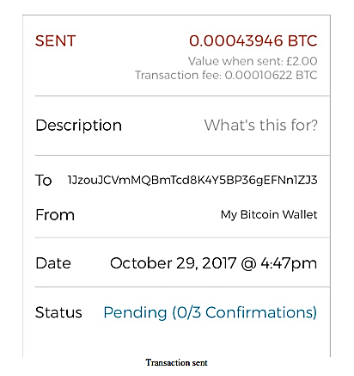
Transaction from wallet

Slide 6
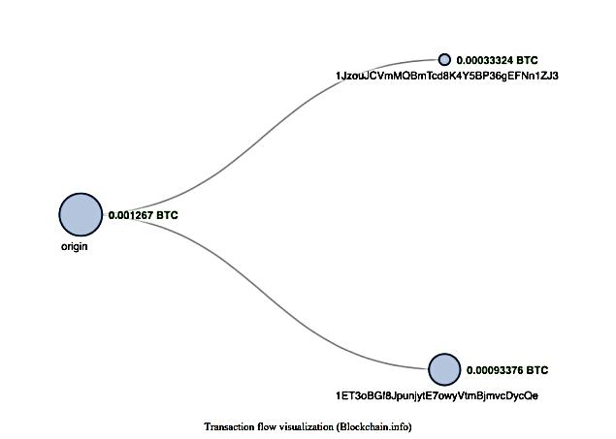
Transaction Validation

Slide 7
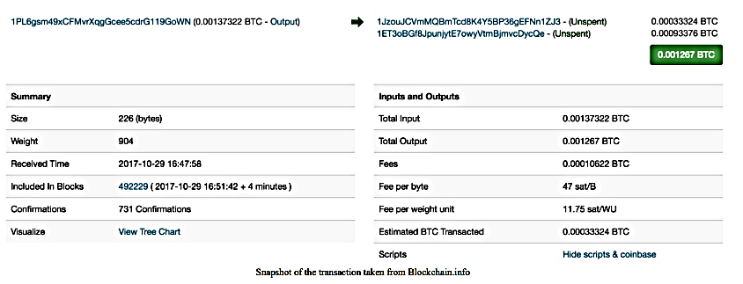
Attributes of the transaction

Slide 8
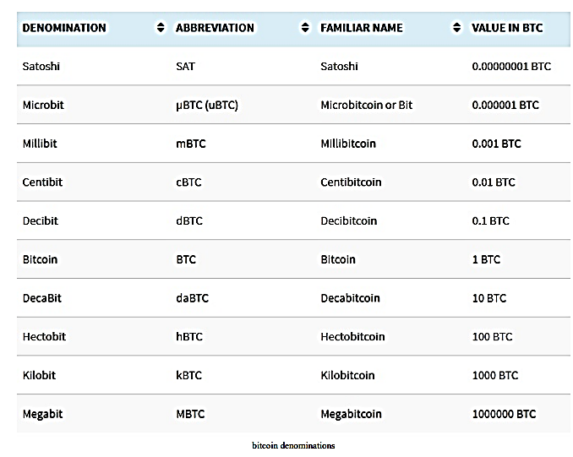
The bitcoin currency units

Slide 9
Digital keys and addresses
Possession of bitcoins and transfer of value via transactions is reliant upon
Private keys
Public keys and
Addresses
Elliptic Curve Cryptography (ECC) is used to generate public and private key pairs in the Bitcoin network.

Slide 10
Private keys in Bitcoin
Private keys are required to be kept safe and normally resides only on the owner's side.
Private keys are used to digitally sign the transactions proving the ownership of the bitcoins.
256-bit numbers randomly chosen in the range specified by the secp256k1 ECDSA curve recommendation.
Private keys are usually encoded using Wallet Import Format (WIF)
Private key:
When it is converted into WIF format it looks like this:
A3ED7EC8A03667180D01FB4251A546C2B9F2FE33507C68B7D9D4E1FA5714195201
L2iN7umV7kbr6LuCmgM27rBnptGbDVc8g4ZBm6EbgTPQXnj1RCZP

Slide 11
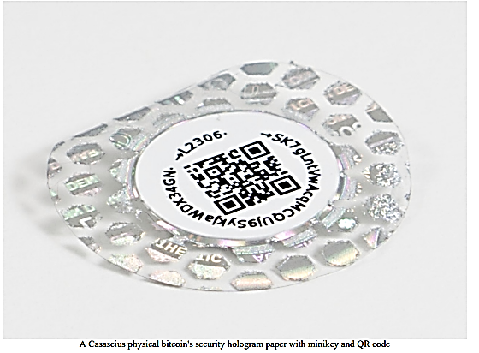
Mini private key format
Mini private key format to create the private key with a maximum of up to 30 characters
The private key encoded using mini private key format is also sometimes called minikey.
A mini private key can be converted into a normal size private key but not vice versa.

Slide 12
Public keys in Bitcoin
Derived from private keys
Special mathematical relationship with the private key
Transaction signed with the private key Bitcoin network, public keys are used by the nodes to verify that the transaction has indeed been signed with the corresponding private key. This process of verification proves the ownership of the bitcoin.
Keys are identified by various prefixes
Uncompressed public keys use 0x04 as the prefix
Compressed public key starts with 0x03 if the y 32-bit part of the public key is odd
Compressed public key starts with 0x02 if the y 32-bit part of the public key is even
ECC based on the secp256k1 standard

Slide 13
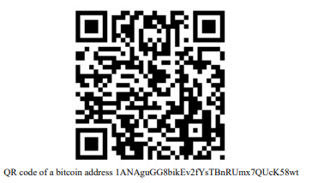
Addresses in Bitcoin
Public Key
SHA-256
RIPEMD-160
Base58Check encoding
26-35 Characters
P2PKH
1ANAguGG8bikEv2fYsTBnRUmx7QUcK58wt

Slide 14
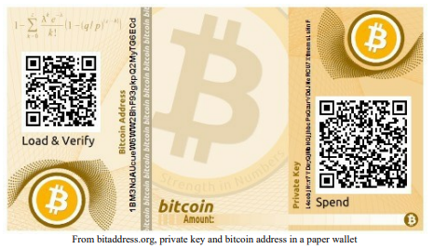

Slide 15
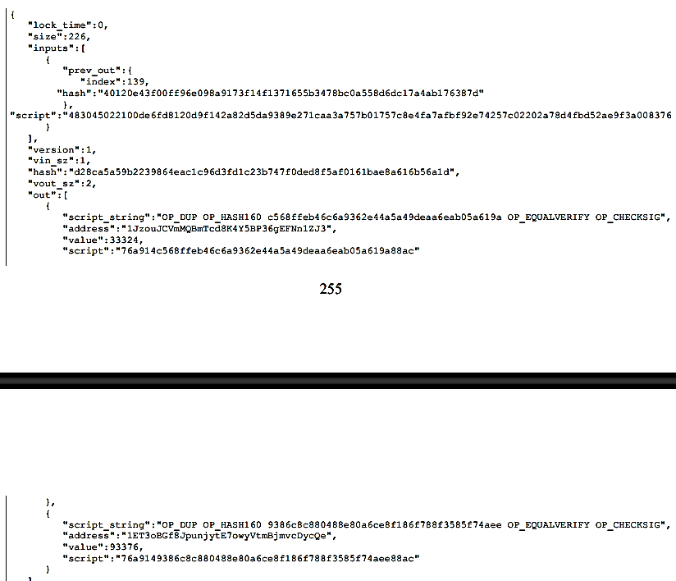
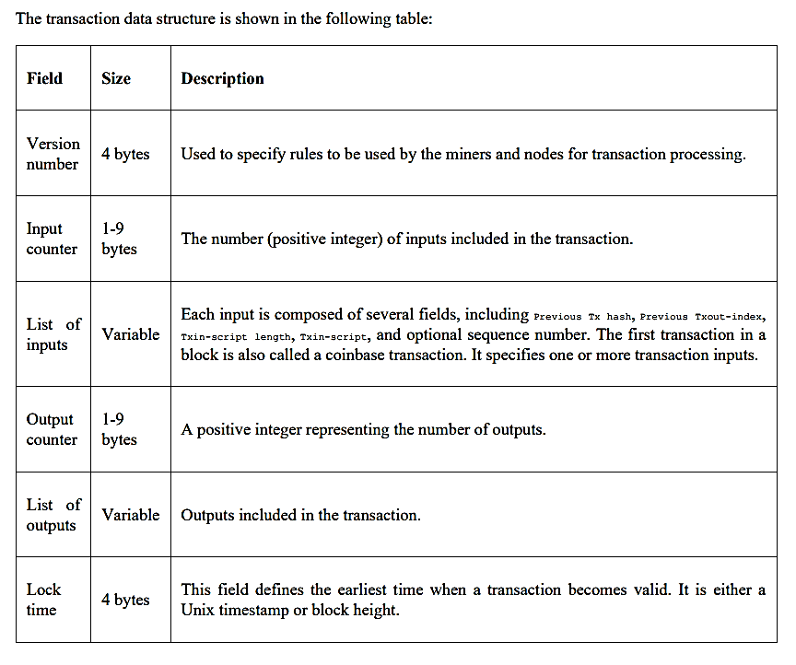

Transaction Data Structure

Slide 16
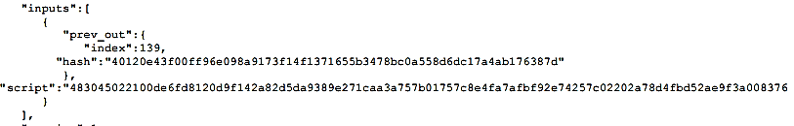
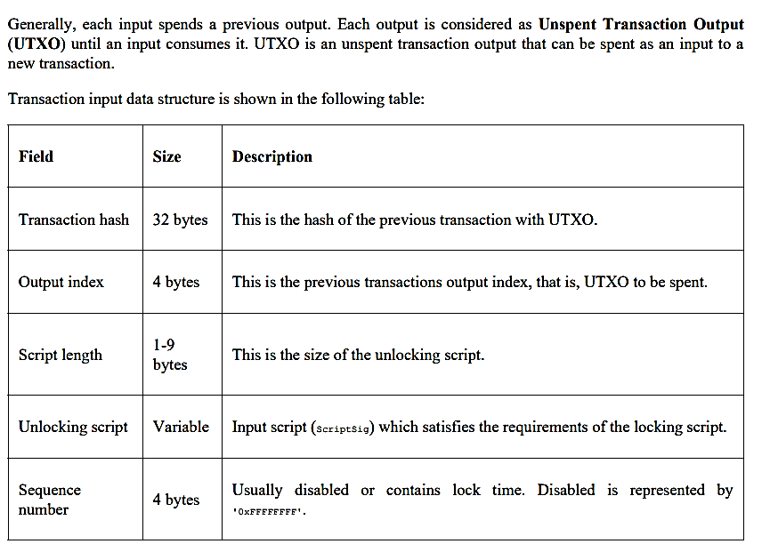
Inputs

Slide 17
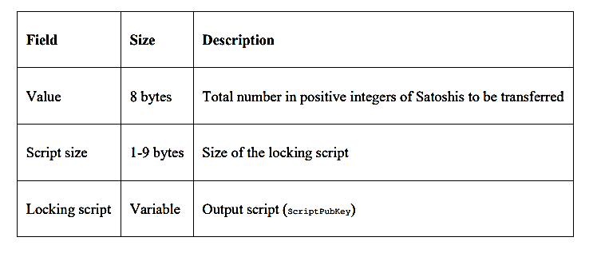
Outputs

